Slide 1
The AI Metadata Assistant
in the Metadata Editor
Yoel Kortick
Senior Librarian
June 2025

Slide 2
Agenda
Introduction
Enabling the AI Metadata Assistant and required roles
Creating a new record using the AI Metadata Assistant
Creating a new record - real live example one
Creating a new record - real live example two
Enriching a brief record using the AI Metadata Assistant
Enriching a brief record - a real live example
Expand from Template with the AI Metadata Assistant
Using a normalization process in the AI Usage Profile
Cropping the image
Using the AI Metadata Assistant for non-Latin script items
Feedback

Slide 3
Introduction

Slide 4
Introduction
This presentation will focus on using the AI Metadata Assistant in the Metadata Editor.
We will show live, with real actual examples, how we can use the AI Metadata Assistant to
  Create a new record - a real live example
  Enrich an existing brief record

Slide 5
Introduction
For additional information regarding the background and release plans of the AI Metadata Assistant see the following additional resources:
  Ex Libris Knowledge Center The AI Metadata Assistant in the Metadata Editor
  Ex Libris Knowledge Center AI Metadata Enrichment for Libraries
  Ex Libris Blog (Sep. 16, 2024) Early Access Customers Begin Testing the AI Metadata Assistant for Alma
  Ex Libris Blog (Aug. 21, 2024) Artificial Intelligence Blog Series: Introducing the AI Metadata Assistant in the Alma Metadata Editor
  Ex Libris YouTube Video (Mar. 28, 2024) Metadata Enrichment using AI – First Glance at Research and Findings

Slide 6
Introduction
The AI Metadata Assistant uses a Large Language Model generative AI to process information about a library resource.
As part of the processing of the information the AI Metadata Assistant can suggest relevant metadata to the cataloger. This can help to make the cataloging process quicker and more efficient.
The cataloger can review the suggested data and accept, correct or dismiss it. He or she can also add additional library-specific metadata.
To process the information, the AI Metadata Assistant can use images of a library resources along with other provided information, extract the text and meaning, and return it structured according to cataloging standards. This information can then be used for creating new bibliographic records, as well as enriching existing brief records.
Note that the metadata and images aren’t used to train the AI or saved by Ex Libris. The metadata and images are only processed to generate metadata suggestions.

Slide 7
Introduction
Disclaimer: Screenshots and other information in this presentation are from June 2025
Because the AI Metadata Assistant is still being actively developed, the information here is subject to future changes.

Slide 8
Enabling the AI Metadata Assistant and required roles

Slide 9
Enabling the AI Metadata Assistant and required roles
Enabling the AI Metadata Assistant is done on the level of the institution and is explained at Enabling the AI Metadata Assistant in Your Alma Environment which is part of The AI Metadata Assistant in the Metadata Editor.
The AI Metadata Assistant is disabled by default in all institutions.
To enable AI Metadata Assistant, the staff user must have the following roles:
  General System Administrator
  Catalog Administrator
The AI Metadata Assistant is enabled at “Configuration > Resources > Cataloging > AI Usage Profile”
After setting the AI Usage Profile to “Yes” and saving, catalogers with the "AI Assisted Cataloging" role will be able to begin using it.

Slide 10
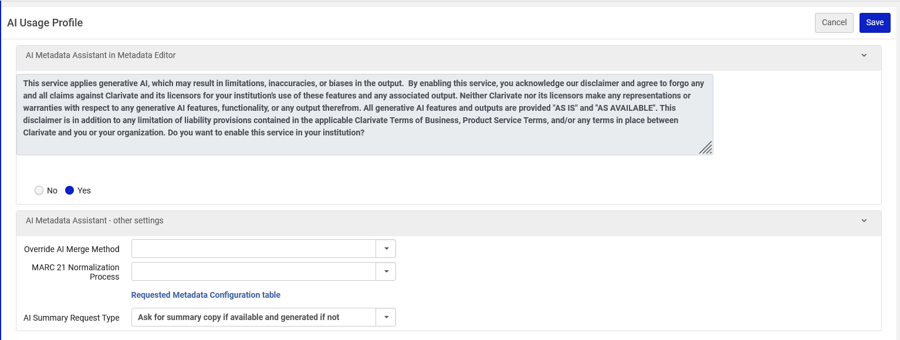
Enabling the AI Metadata Assistant and required roles
The AI Metadata Assistant has been enabled
Note that there is a default merge rule in which no library data is overridden. Via the default merge rule repeatable fields will be added, and non repeatable fields will be added if not already in the record.

Slide 11
Enabling the AI Metadata Assistant and required roles
To work with the AI Metadata Assistant in the Metadata Editor, the staff user must have both the following roles:
  Cataloger
  AI Assisted Cataloging
Note that the role "AI Assisted Cataloging" is available without enabling the AI MD Assistant, but it will not be functional without first enabling the AI Metadata Assistant.

Slide 12
Enabling the AI Metadata Assistant and required roles
In our Alma Institution cataloger Alicia Chen has the following roles

Slide 13
Creating a new record using the AI Metadata Assistant

Slide 14
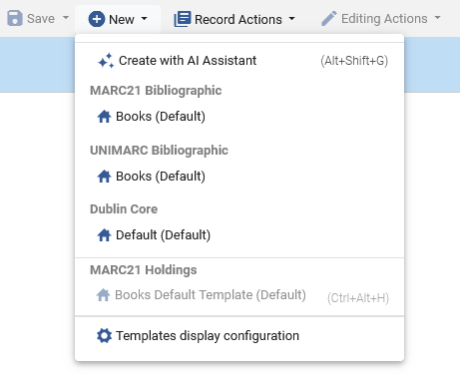
Creating a new record using the AI Metadata Assistant
To create a new record using the AI Metadata Assistant from within the Metadata Editor select "New > Create with AI Assistant".
The “Create with AI Assistant” menu entry will appear only if the institution has enabled the AI metadata Assistant, and the staff user has roles “Cataloger” and “AI Assisted Cataloging“

Slide 15
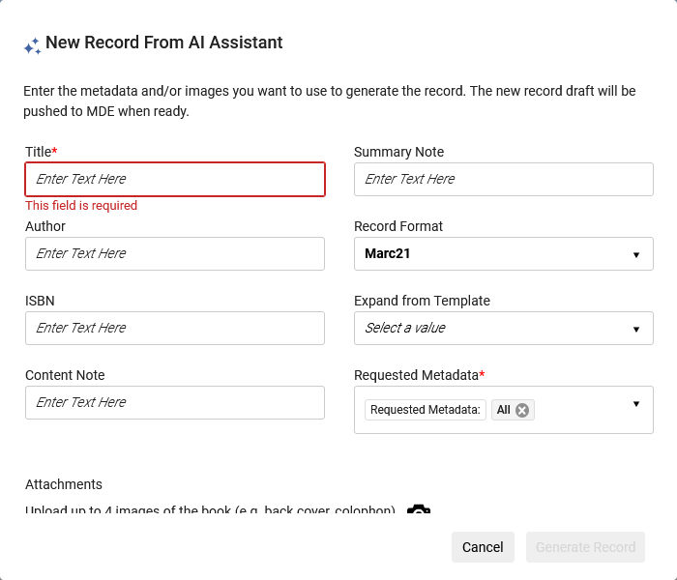
Creating a new record using the AI Metadata Assistant
The "New Record from AI Assistant" pop-up will open.
These fields are described at Creating a New Record using the AI Metadata Assistant on the Ex Libris Knowledge Center:

Slide 16
Creating a new record - real live example one

Slide 17
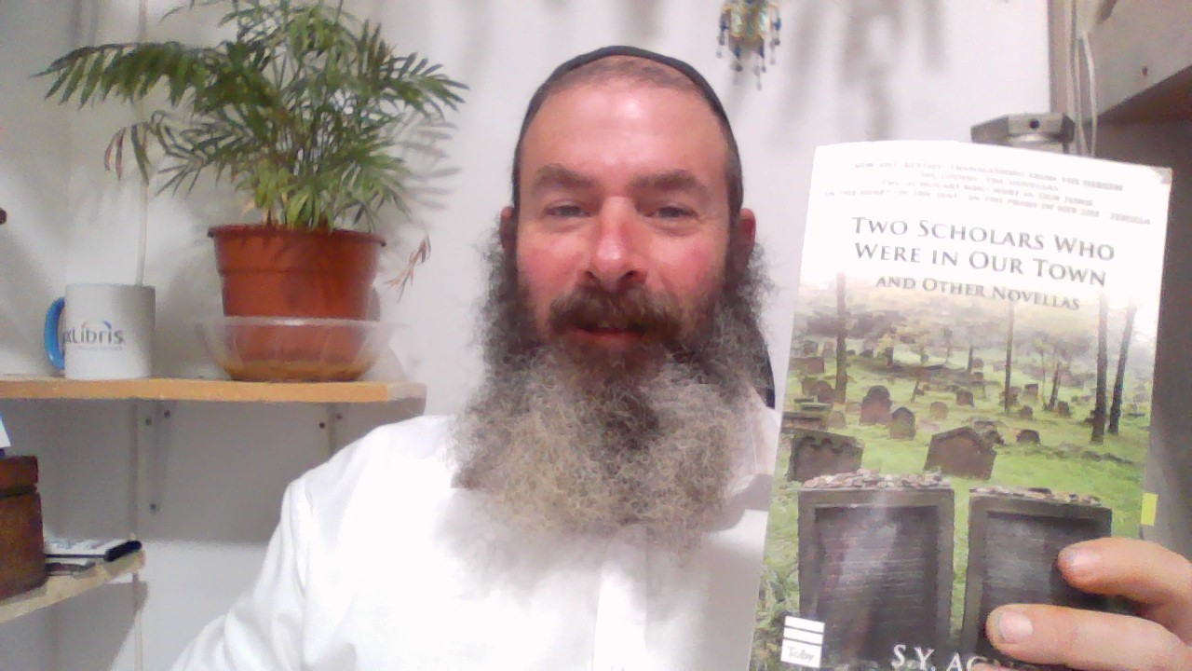
Creating a new record - real live example one
We will now create a new record for title “Two scholars who were in our town” by author “Agnon, S. Y.”
The cataloger has it in hand.

Slide 18

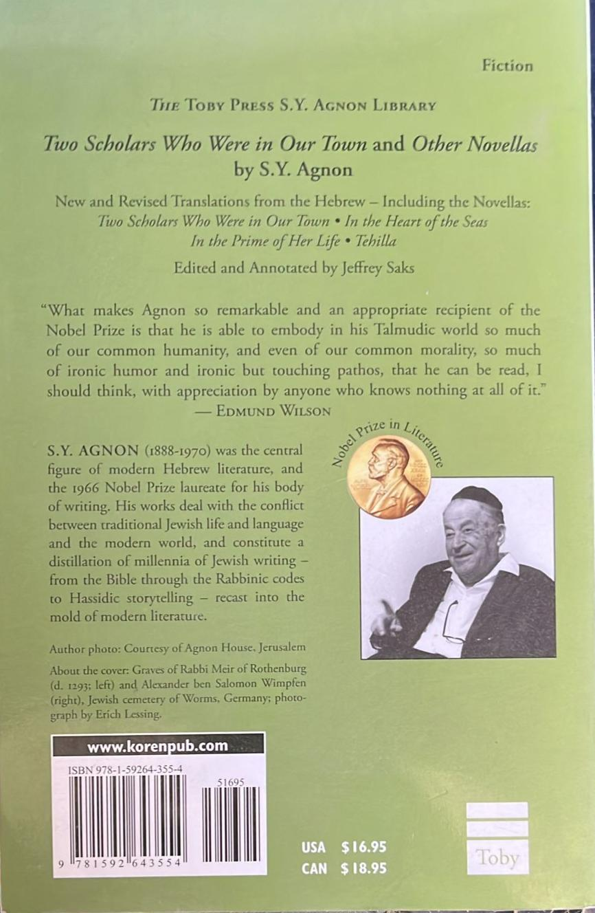
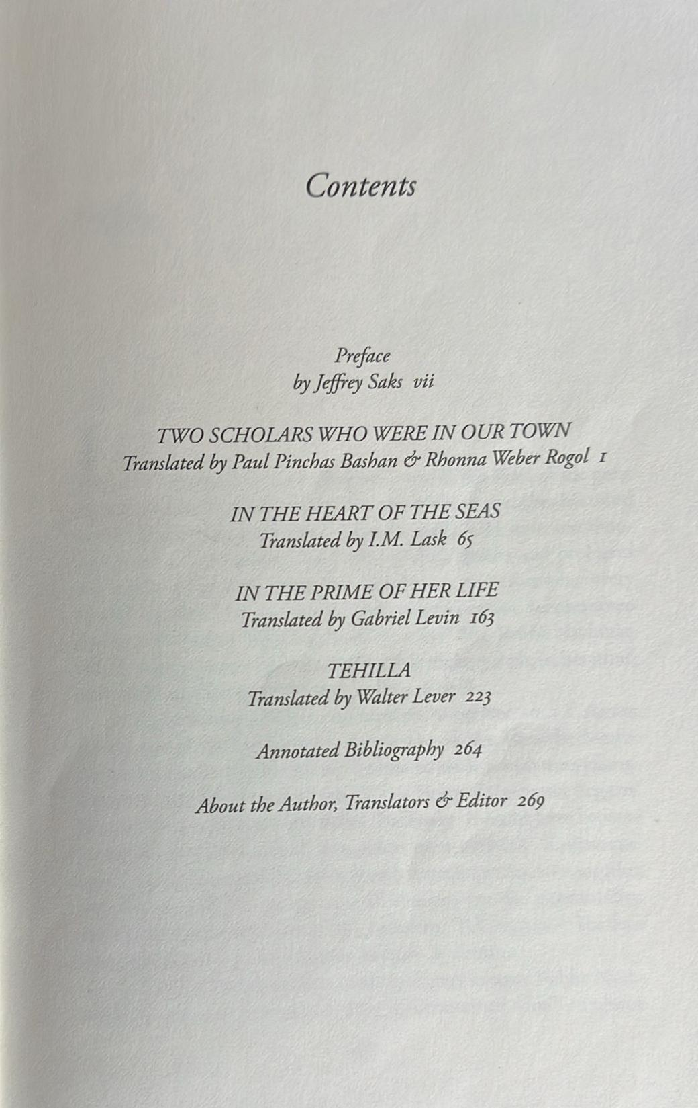
Creating a new record - real live example one
The cataloger has photographed the front cover, back cover, and table of contents.

Slide 19
Creating a new record - real live example one
While in the Metadata Editor we will now do "New > Create with AI Assistant" and fill in the information.
Details are on the next slide.
We will load all three images to the “New record from AI Assistant” page and enter only the title (the only mandatory field)

Slide 20
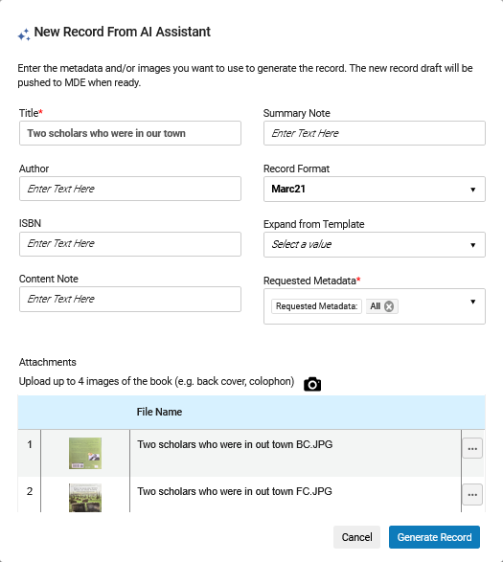
Creating a new record - real live example one
We will talk more about “Expand from Template” later
Only the title has been added. Author and ISBN have been left blank (even though we do have that information, we are showing that it is not necessary)
We uploaded the three images from the PC. We could also have used the webcam by clicking the camera icon here (future plans include the ability to do this via the Alma Mobile Application)

Slide 21
Creating a new record - real live example one
We will now click “Generate Record”

Slide 22
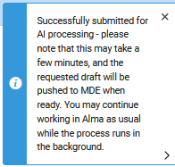
Creating a new record - real live example one
We receive the following message: "Successfully submitted for AI processing - please note that this may take a few minutes, and the requested draft will be pushed to MDE when ready. You may continue working in Alma as usual while the process runs in the background."

Slide 23
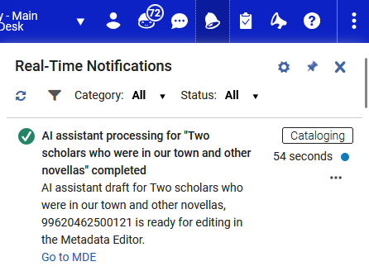
Creating a new record - real live example one
Shortly thereafter we receive the following Real-Time Notification: "AI assistant processing for "Two scholars who were in our town and other novellas" completed. AI assistant draft for Two scholars who were in our town and other novellas, 99620462500121 is ready for editing in the Metadata Editor. Go to MDE."

Slide 24
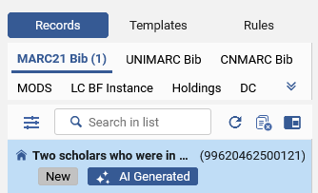
Creating a new record - real live example one
The new record appears in the navigation pane of the Metadata Editor with an "AI Generated" badge.
The badge enables the cataloger to easily identify the fact that this is an AI generated draft requiring review and is removed once the record has been saved.
Note that this is only a draft and has not yet been saved.
The record has not been saved. It is "New" and can be edited and then saved

Slide 25
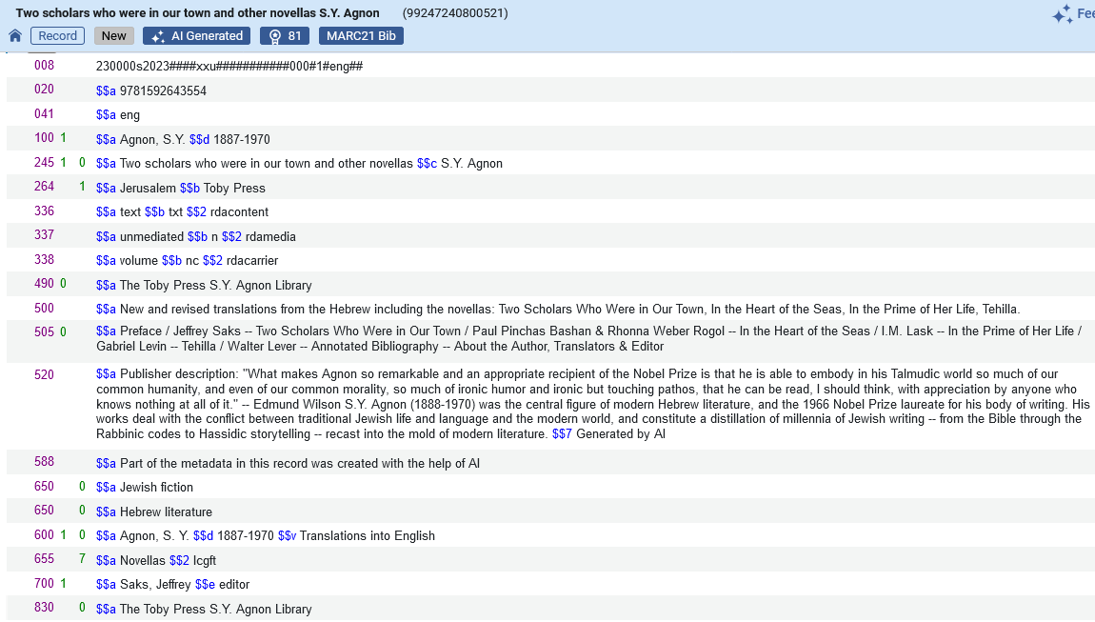
Creating a new record - real live example one
Here is the new record
The ISBN and language code were automatically correctly added
The record includes an “AI Generated” badge.
The publication information was automatically correctly added
The formatted contents note was automatically correctly added
The Summary, etc. was automatically correctly added
The Source of Description Note was automatically added
These LC subject headings were automatically added
These Added Entry Personal Name fields were automatically added
The Index Term Genre / Form heading for Library of Congress Genre/Form Terms (lcgft) was automatically added
The Series Added Entry was automatically added

Slide 26
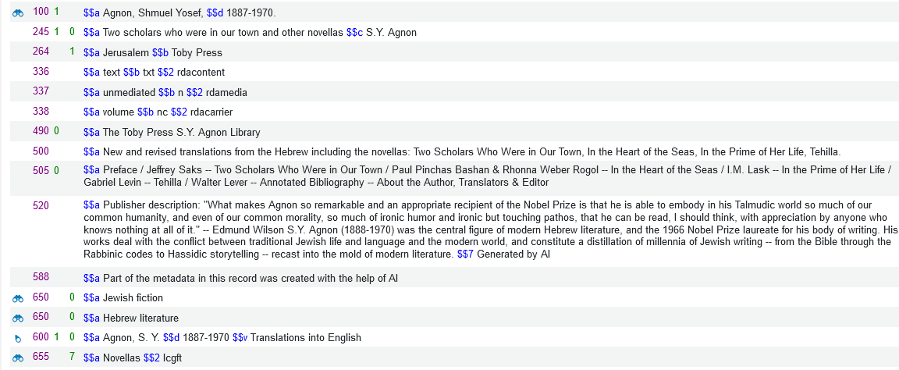
Creating a new record - real live example one
Now we can edit as desired and save. The new saved record is below (partial screenshot).
Note that after saving the record the headings automatically got linked, for example, to LCNAMES, LCSH and Library of Congress Genre/Form Terms (lcgft) vocabularies.

Slide 27
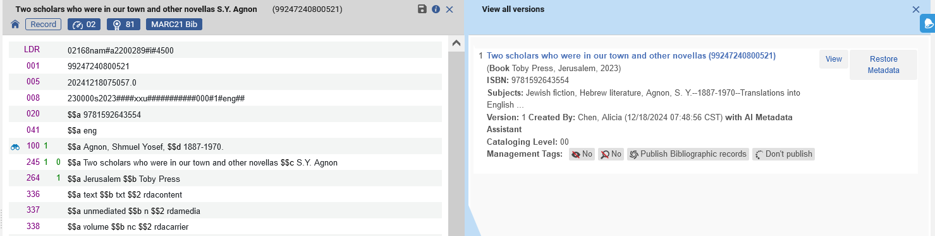
Creating a new record - real live example one
Note also that when doing “View related Data > View Versions” there is a statement in the versions if the record was created via the AI metadata Assistant. We have edited the record and saved, and now see this in the “View Versions”

Slide 28
Creating a new record - real live example two

Slide 29
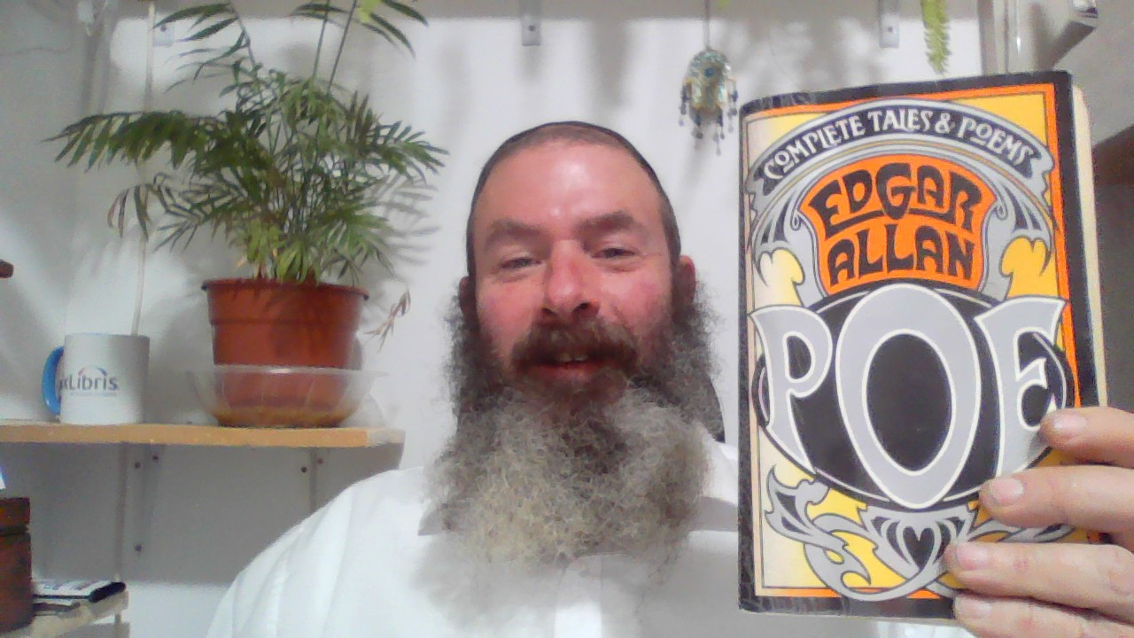
Creating a new record - real live example two
We will now create a new record for title "The Complete Tales and Poems of Edgar Allan Poe" by author " Edgar Allan Poe".
The cataloger has it in hand.

Slide 30

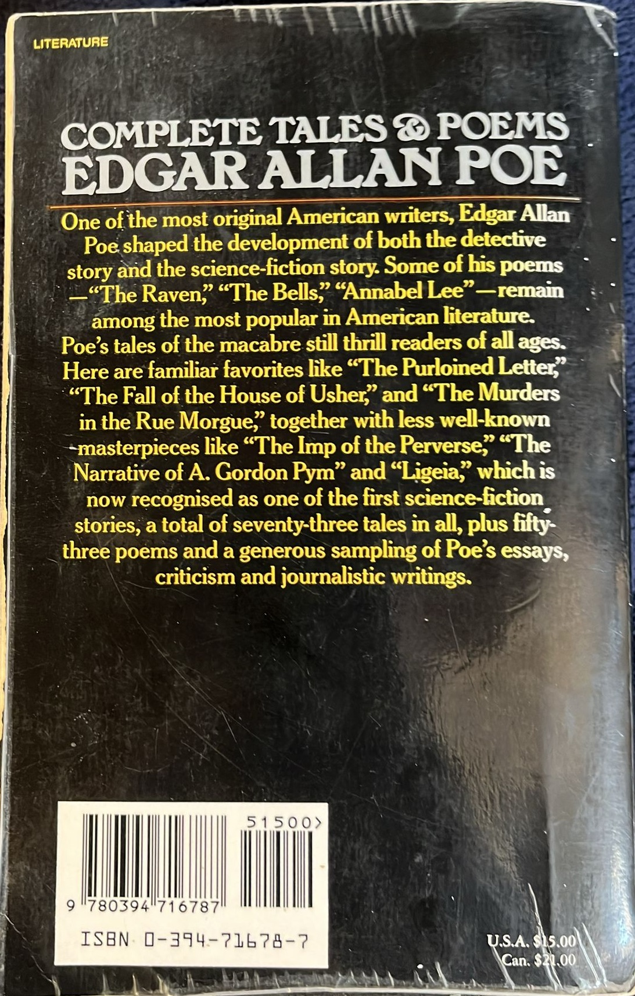
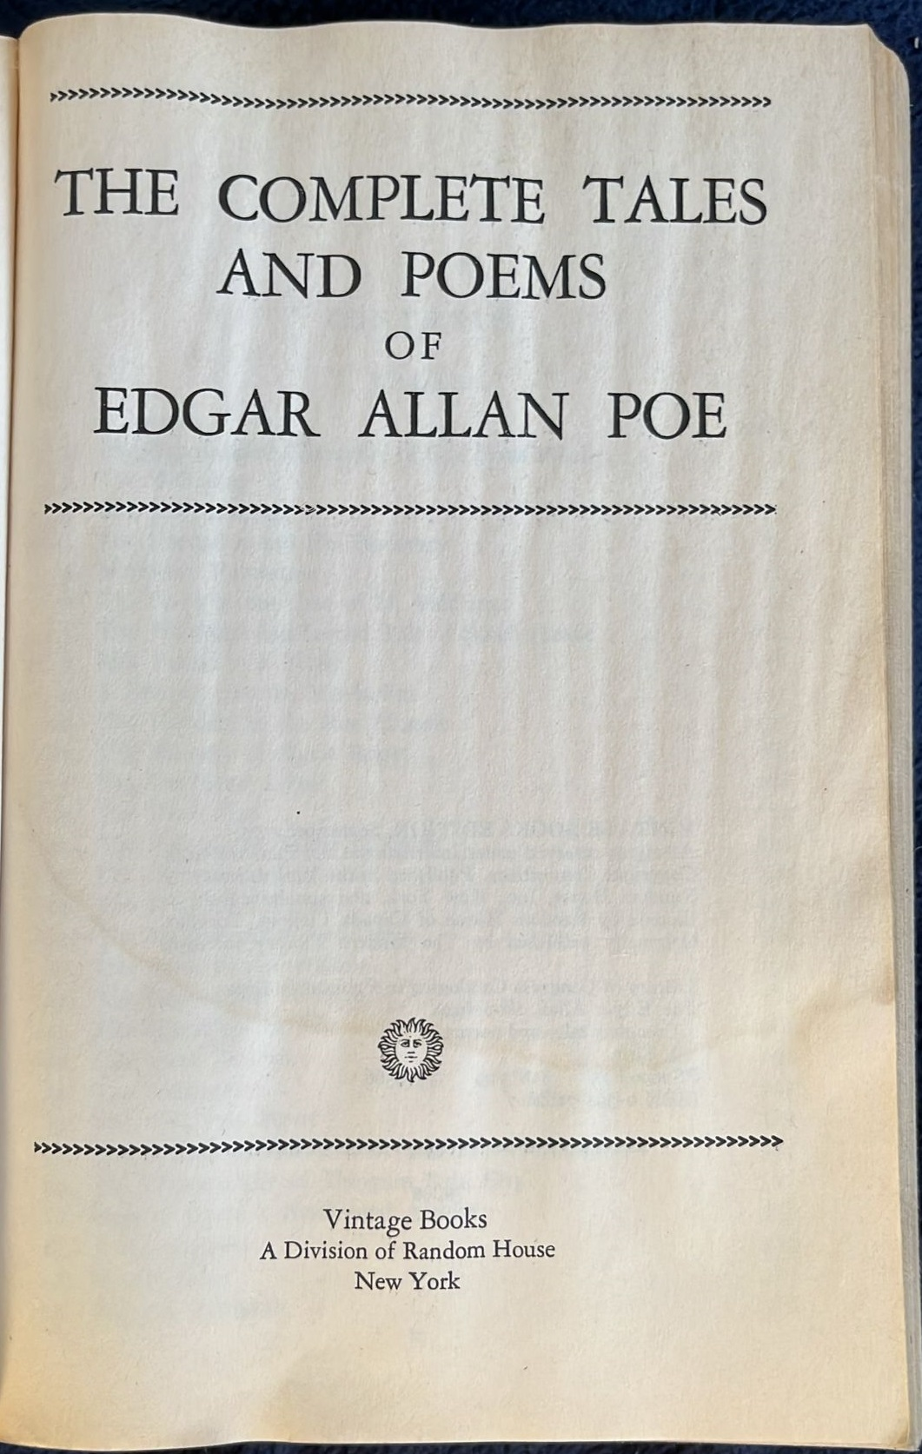
Creating a new record - real live example two
The cataloger has photographed the front cover, back cover, and title page.

Slide 31
Creating a new record - real live example two
While in the Metadata Editor we will now do "New > Create with AI Assistant" and fill in the information.
Details are on the next slide.
We will load all three images to the “New record from AI Assistant” page and enter only the title (the only mandatory field)

Slide 32
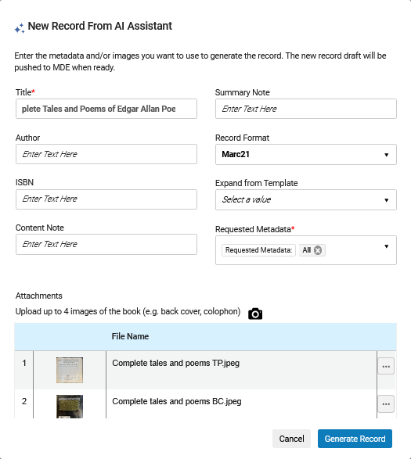
Creating a new record - real live example two
We will talk more about “Expand from Template” later
Only the title has been added. Author and ISBN have been left blank (even though we do have that information, we are showing that it is not necessary)
We uploaded the three images from the PC. We could also have used the webcam by clicking the camera icon here (future plans include the ability to do this via the Alma Mobile Application)

Slide 33
Creating a new record - real live example two
We will now click “Generate Record”

Slide 34
Creating a new record - real live example two
We receive the following message: "Successfully submitted for AI processing - please note that this may take a few minutes, and the requested draft will be pushed to MDE when ready. You may continue working in Alma as usual while the process runs in the background."

Slide 35
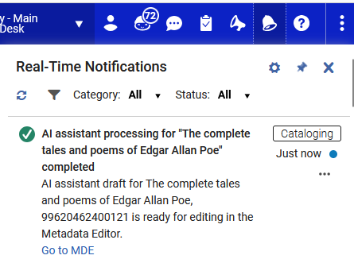
Creating a new record - real live example two
Shortly thereafter we receive the following Real-Time Notification: " AI assistant processing for "The Complete Tales and Poems of Edgar Allan Poe" completed. AI assistant draft for The Complete Tales and Poems of Edgar Allan Poe, 99620462400121 is ready for editing in the Metadata Editor. Go to MDE."

Slide 36
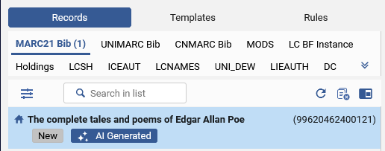
Creating a new record - real live example two
The new record appears in the navigation pane of the Metadata Editor with an "AI Generated" badge.
Note that this is only a draft and has not yet been saved.
The record has not been saved. It is "New" and can be edited and then saved

Slide 37
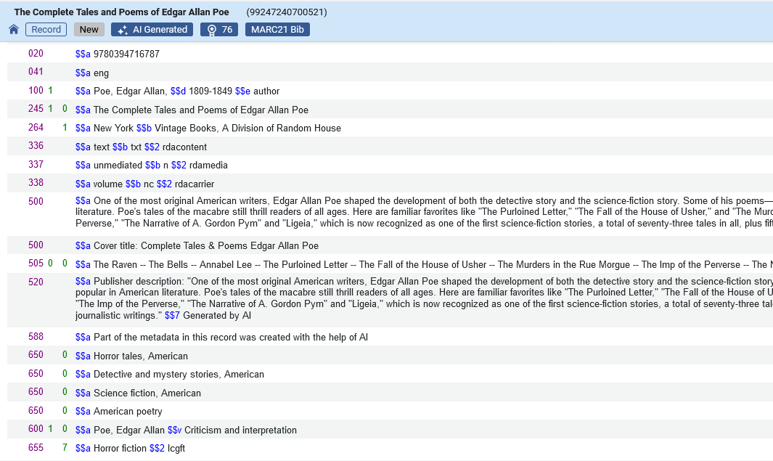
Creating a new record - real live example two
Here is the new record
The ISBN and language code were automatically correctly added
The record includes an “AI Generated” badge.
The publication information was automatically correctly added
The formatted contents note was automatically correctly added
The Summary, etc. was automatically correctly added
The Source of Description Note was automatically added
These LC subject headings were automatically added
The Index Term Genre / Form heading for Library of Congress Genre/Form Terms (lcgft) was automatically added

Slide 38
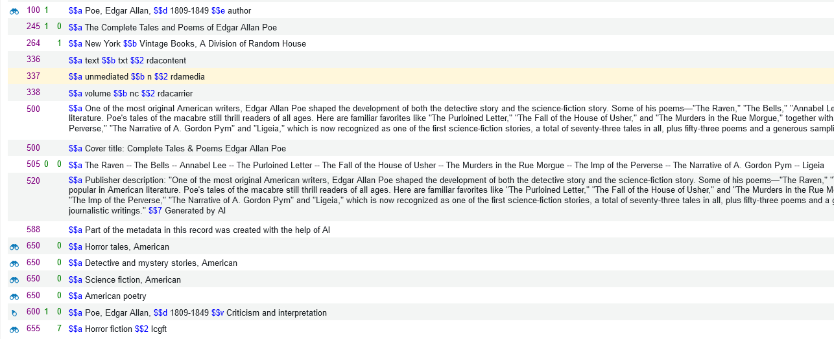
Creating a new record - real live example two
Now we can edit as desired and save. The new saved record is below (partial screenshot).
Note that after saving the record the headings automatically got linked, for example, to LCNAMES, LCSH and Library of Congress Genre/Form Terms (lcgft) vocabularies.

Slide 39
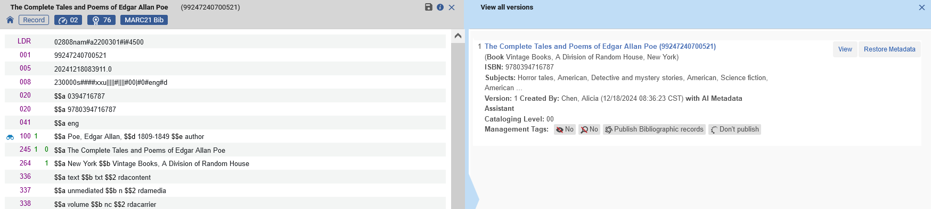
Creating a new record - real live example two
Note also that when doing “View related Data > View Versions” there is a statement in the versions if the record was created via the AI metadata Assistant. We have edited the record and saved, and now see this in the “View Versions”

Slide 40
Enriching a brief record using the AI Metadata Assistant

Slide 41
Enriching a brief record using the AI Metadata Assistant
To enrich an existing brief record using the AI Metadata Assistant from within the Metadata Editor
  Open the record to be enriched in the Metadata Editor in edit mode.
  Select "Editing Actions > Enhance with AI Assistant".
  If desired attach images
  Click "Enrich Record"

Slide 42
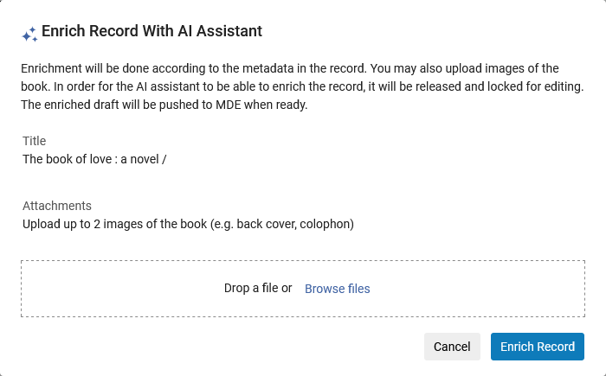
Enriching a brief record using the AI Metadata Assistant
The "Enrich Record from AI Assistant" pop-up will open.

Slide 43

Enriching a brief record using the AI Metadata Assistant
We will be enriching the following record: Author: Frankl, Victor. Title: Man’s search for meaning. ISBN: 9780807014271
The cataloger has it in hand.

Slide 44
Enriching a brief record - a real live example

Slide 45
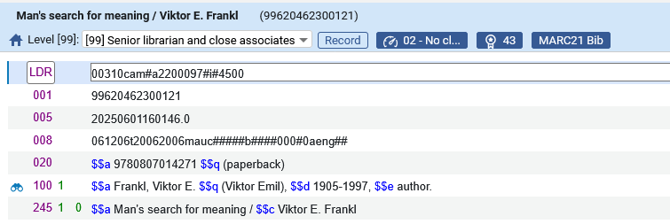
Enriching a brief record - a real live example
We have the following brief record which we want to enrich using AI
Author: Frankl, Victor.
Title: Man’s search for meaning.
ISBN: 9780807014271
These are the only fields which we currently have in the record

Slide 46
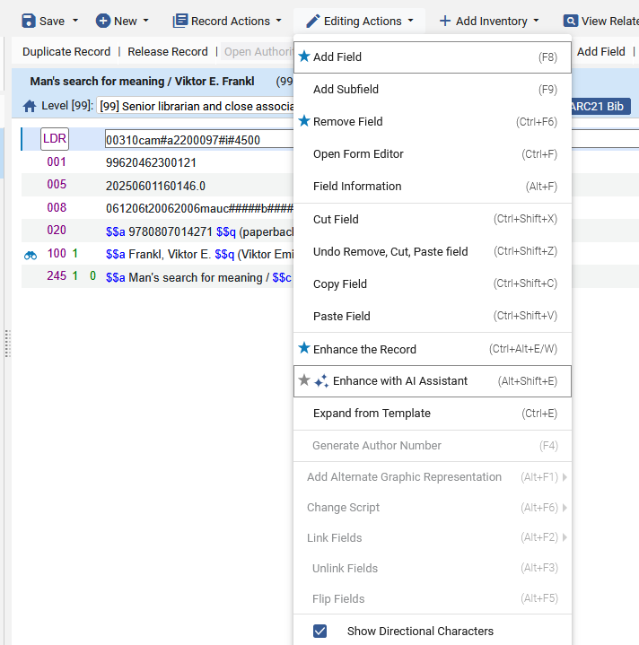
Enriching a brief record - a real live example
With the record open in edit mode we choose "Editing Actions > Enhance with AI Assistant"

Slide 47
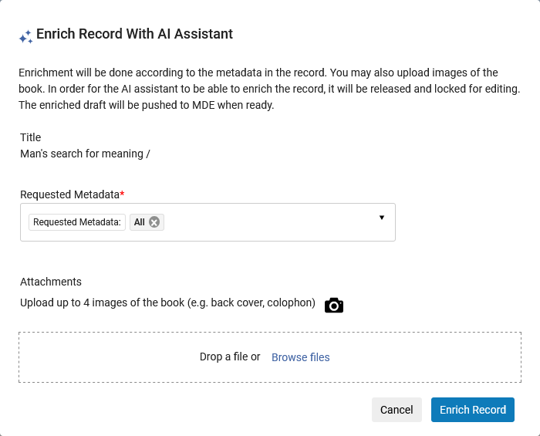
Enriching a brief record - a real live example
We get the following pop-up screen

Slide 48
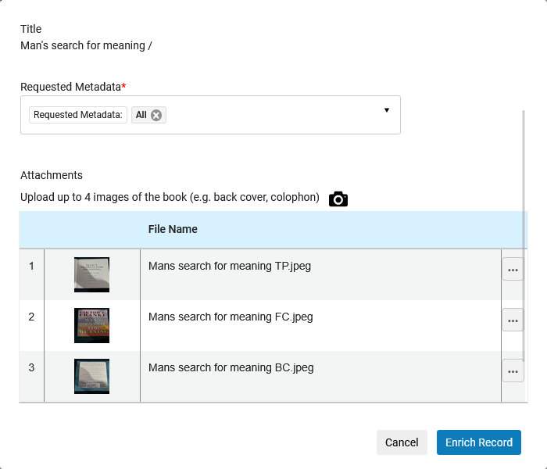
Enriching a brief record - a real live example
We add the images and click "Enrich Record"
We uploaded a front cover, back cover and title page image from the PC. We could also have used the webcam by clicking the camera icon here (future plans include the ability to do this via the Alma Mobile Application)

Slide 49
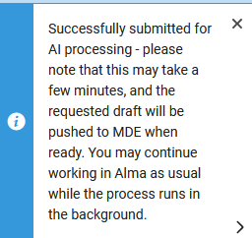
Enriching a brief record - a real live example
We get a message "Successfully submitted for AI processing - please note that this may take a few minutes, and the requested draft will be pushed to MDE when ready. You may continue working in Alma as usual while the process runs in the background."

Slide 50
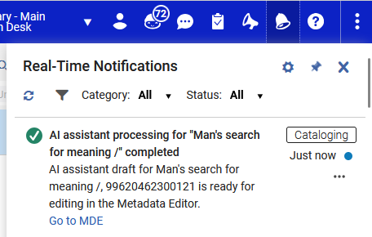
Enriching a brief record - a real live example
Shortly thereafter we receive the following Real-Time Notification: “AI assistant processing for "Man’s search for meaning" completed. AI assistant draft for Man’s search for meaning, 99620462300121 is ready for editing in the Metadata Editor. Go to MDE. ”

Slide 51
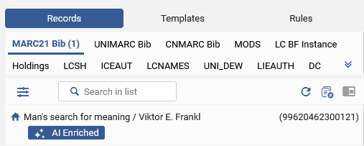
Enriching a brief record - a real live example
The enriched record appears in the navigation pane of the Metadata Editor with an "AI Enriched" badge.
The badge enables the cataloger to easily identify the fact that this is an AI generated draft requiring review and is removed once the record has been saved.

Slide 52
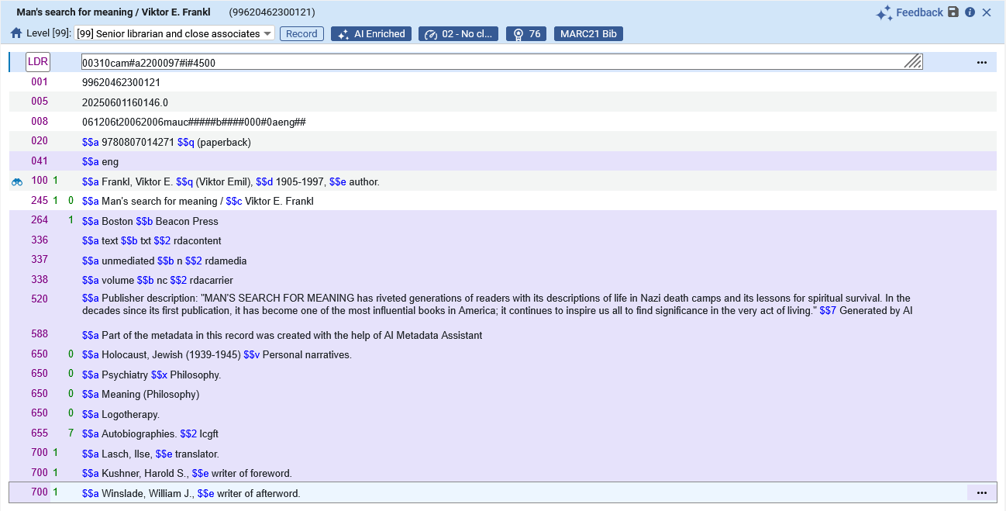
Enriching a brief record - a real live example
Here is the enriched record
The following fields (denoted as new fields via the color purple) have been added:

Slide 53
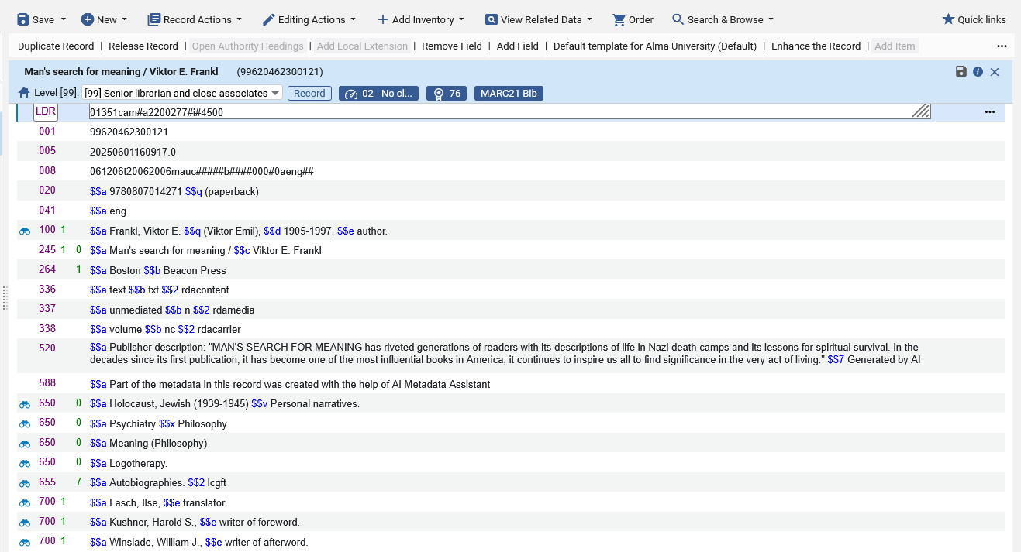
Enriching a brief record - a real live example
Here is the enriched record after saving. If desired, we can change the existing metadata and add additional metadata.
After saving the record multiple headings linked to the relevant authority records.

Slide 54
Expand from Template with the AI Metadata Assistant

Slide 55
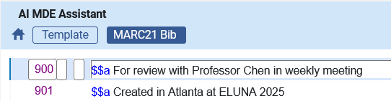
Expand from Template with the AI Metadata Assistant
When using the “Expand from template” option when doing “Create with AI Assistant” it is possible to automatically add field (“expand” fields) from a template to the new record.
We have, for example, this template named “AI MDE Assistant” (the template can have any name).
It has these two fields:
900__ $$a For review with Professor Chen in weekly meeting
901__ $$a Created in Atlanta at ELUNA 2025
Here is the template:

Slide 56
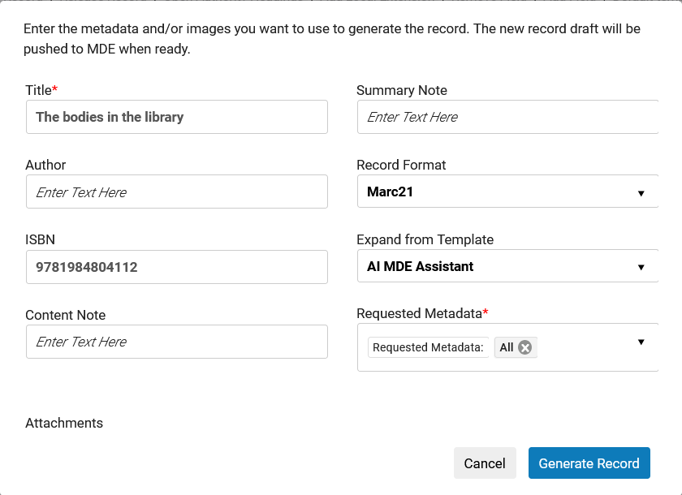
Expand from Template with the AI Metadata Assistant
We will now create a new record from the AI Assistant and this time we will choose the template “AI MDE Assistant” in the field “Expand from template”.
This option is “sticky”, meaning that it “remembers” what template was chosen and it will be automatically chosen (filled in) for the same user next time he or she does “New > Create with AI Assistant”
We have chosen the template here.
We will click “Generate Record”

Slide 57
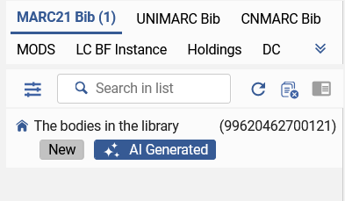
Expand from Template with the AI Metadata Assistant
The new bibliographic record is created

Slide 58
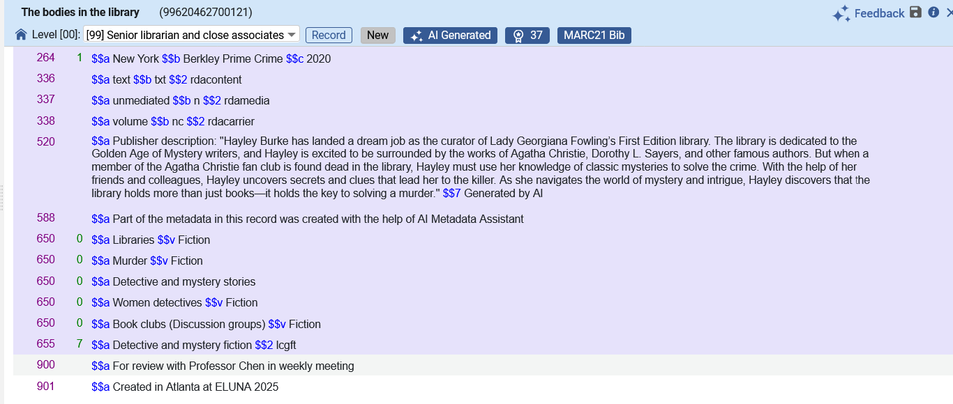
Expand from Template with the AI Metadata Assistant
The new bibliographic record includes the fields from the template from which we expanded

Slide 59
Using a normalization process in the AI Usage Profile

Slide 60
Using a normalization process in the AI Usage Profile
In the AI Usage Profile at "Configuration > Resources > Cataloging > AI Usage Profile" it is possible to use both
  A normalization process (to use when doing "New > Create with AI Assistant")
  A merge rule (to use when doing "Editing Actions > Enhance with AI Assistant")
The normalization rule will be applied to the AI generated data in both the "Create" and "Enhance" workflows.
  In the "Enhance" workflow it will be applied before merging with the existing record.
We will now focus on the normalization process

Slide 61
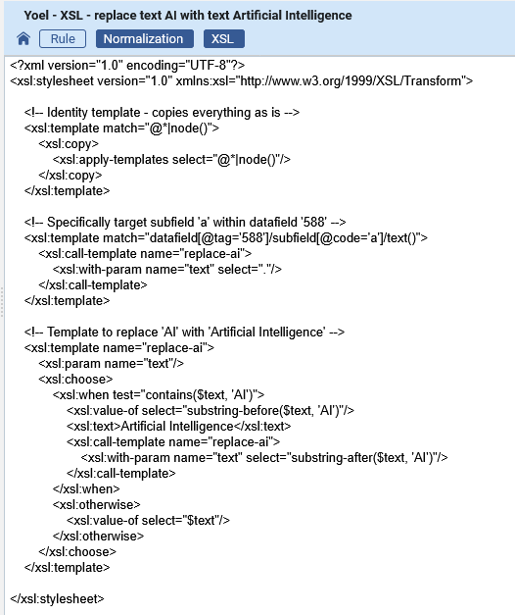
Using a normalization process in the AI Usage Profile
We have a normalization rule and process named "Yoel - XSL - replace text AI" which uses a normalization rule names "Yoel - XSL - replace text AI with text Artificial Intelligence".
It replaces "AI" with "Artificial Intelligence" in 588 a":

Slide 62
Using a normalization process in the AI Usage Profile
The normalization rule will change this:
588__ $$a $$a Part of the metadata in this record was created with the help of AI Metadata Assistant
To this:
588__ $$a $$a Part of the metadata in this record was created with the help of Artificial Intelligence Metadata Assistant

Slide 63
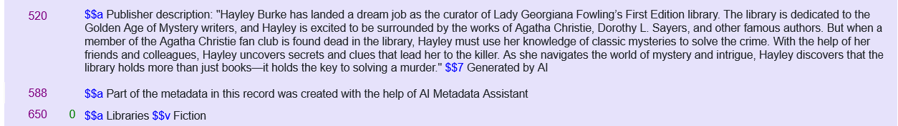
Using a normalization process in the AI Usage Profile
By default all AI generated records have included this:
588__ $$a Part of the metadata in this record was created with the help of AI Metadata Assistant

Slide 64
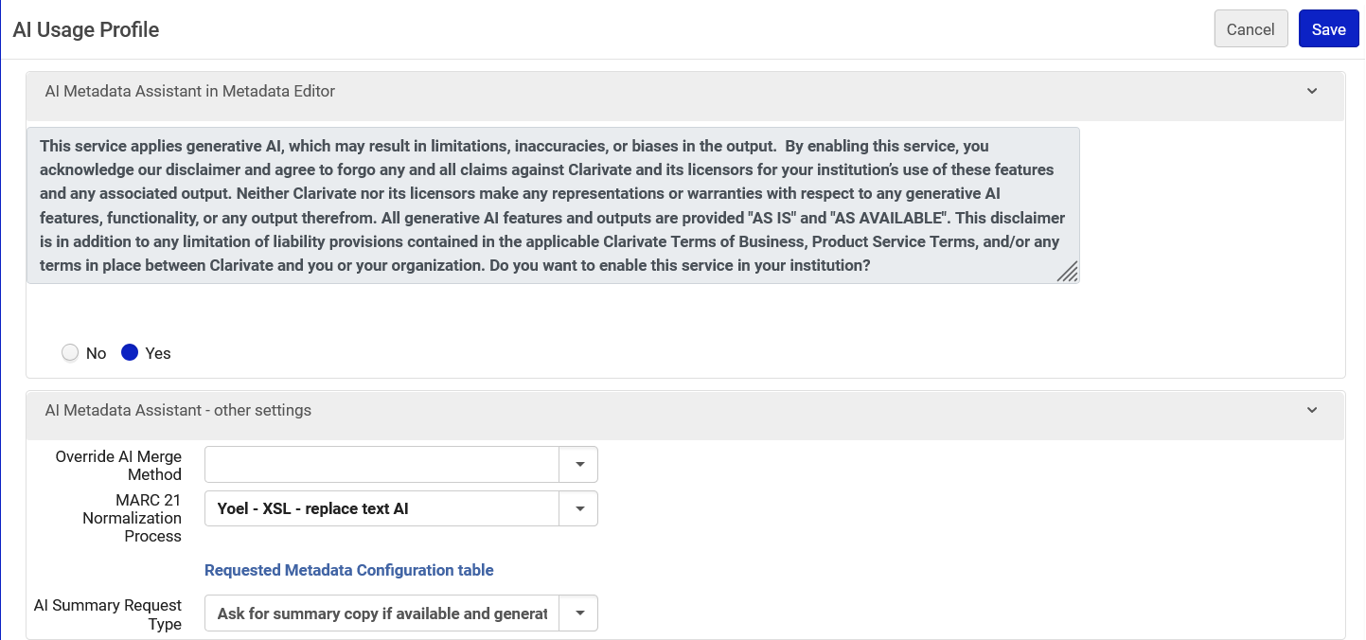
Using a normalization process in the AI Usage Profile
Now we have added the normalization process to the AI Usage Profile at "Configuration > Resources > Cataloging > AI Usage Profile"

Slide 65
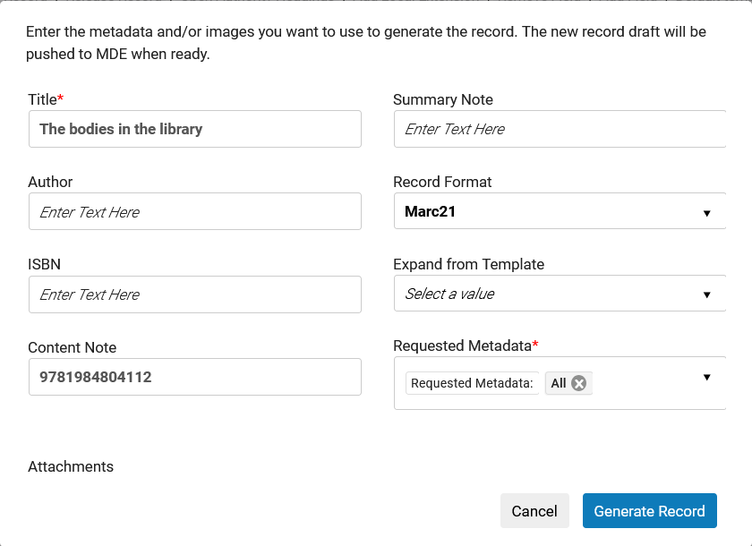
Using a normalization process in the AI Usage Profile
The record is generated

Slide 66
Using a normalization process in the AI Usage Profile
The 588 subfield a is created with:
  Part of the metadata in this record was created with the help of Artificial Intelligence Metadata Assistant
Instead of
  Part of the metadata in this record was created with the help of AI Metadata Assistant
This occurred because of the normalization process in the AI Usage Profile

Slide 67
Cropping the image

Slide 68

Cropping the image
When loading the image to the “New record From AI Assistant” screen it is possible to crop the image.
This prevents the need to crop the images before loading them.
For example, we may have an image such as the following and want to load only the image for “Collected stories of Isaac Bashevis Singer”.

Slide 69
Cropping the image
We will now use the “New record From AI Assistant” to create a new record for :Collected stories of Isaac Bashevis Singer” and crop the image.

Slide 70
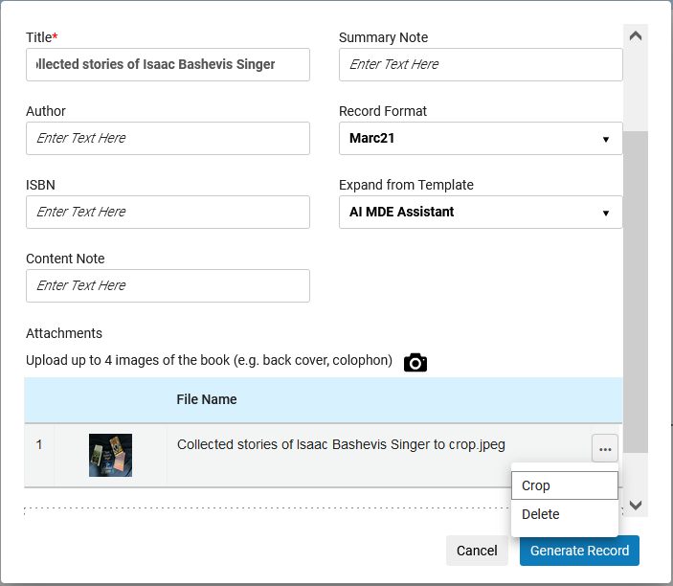
Cropping the image
We will now load an image and choose to crop it.
By the way … the “Expand from Template” is automatically filled in because we filled it in last time and it is “sticky”

Slide 71
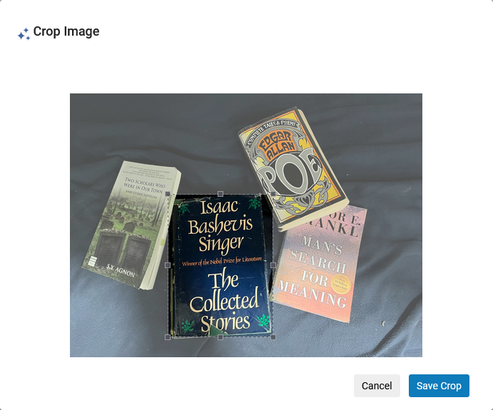
Cropping the image
We will crop only the desired part of the image and save the crop

Slide 72
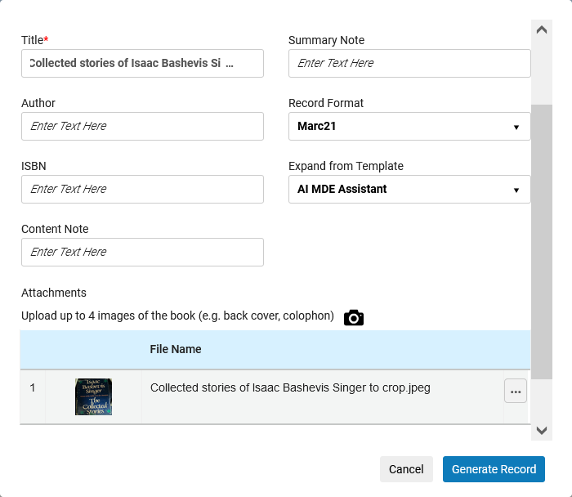
Cropping the image
Now we will generate the record

Slide 73
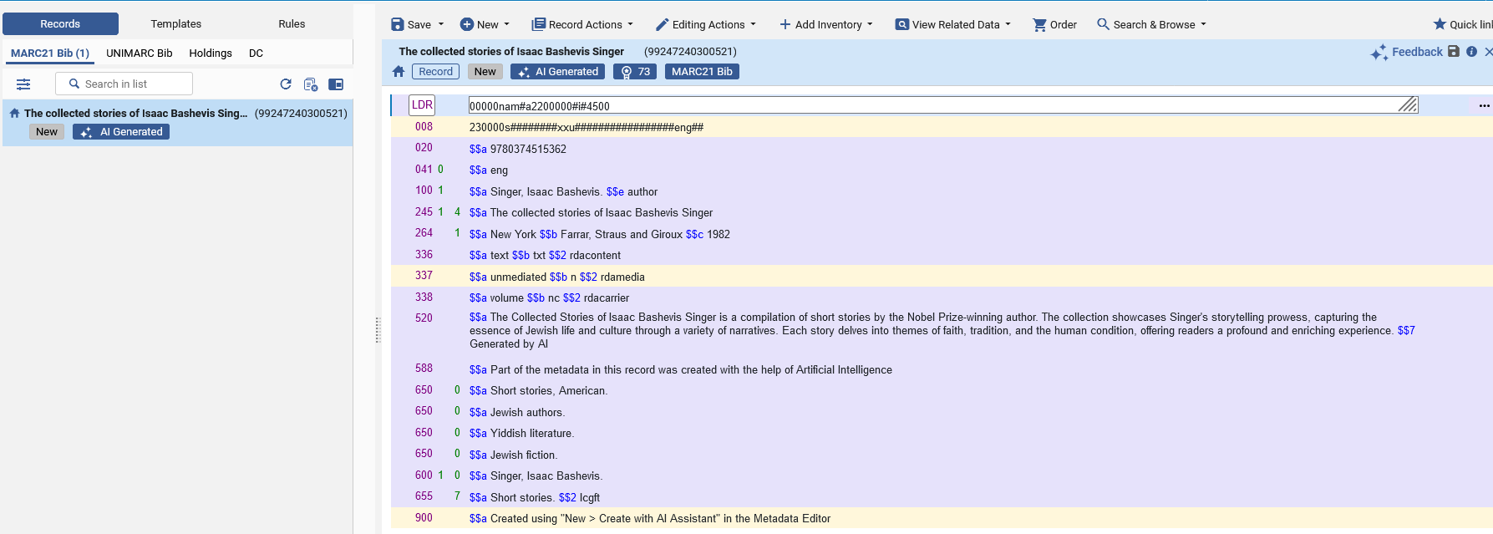
Cropping the image
The new record is generated

Slide 74
Using the AI Metadata Assistant for non-Latin script items

Slide 75

Using the AI Metadata Assistant for non-Latin script items
We will now create a new record for a title which is on non-Latin script, title “ספר חת"ת” (Sefer Hitat)
Note that AI processing may differ for resources in different languages – we recommend carefully assessing and reviewing its responses.
The cataloger has it in hand.

Slide 76

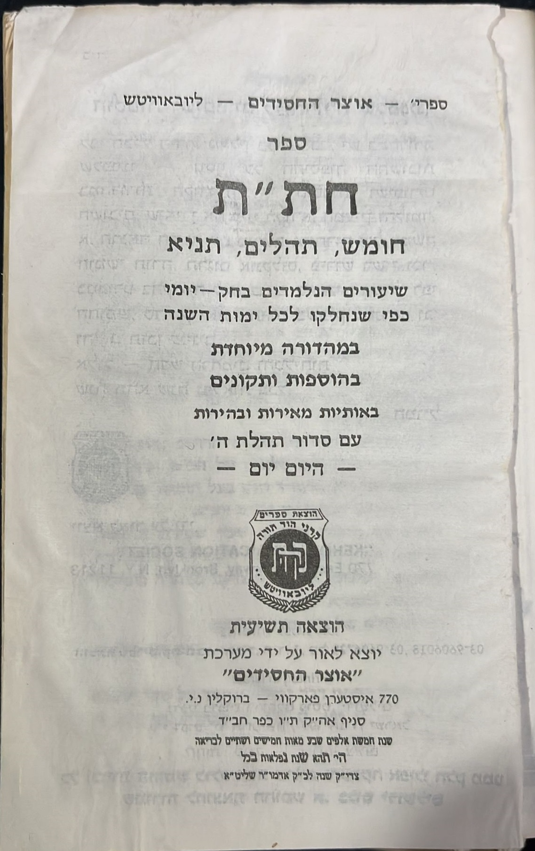
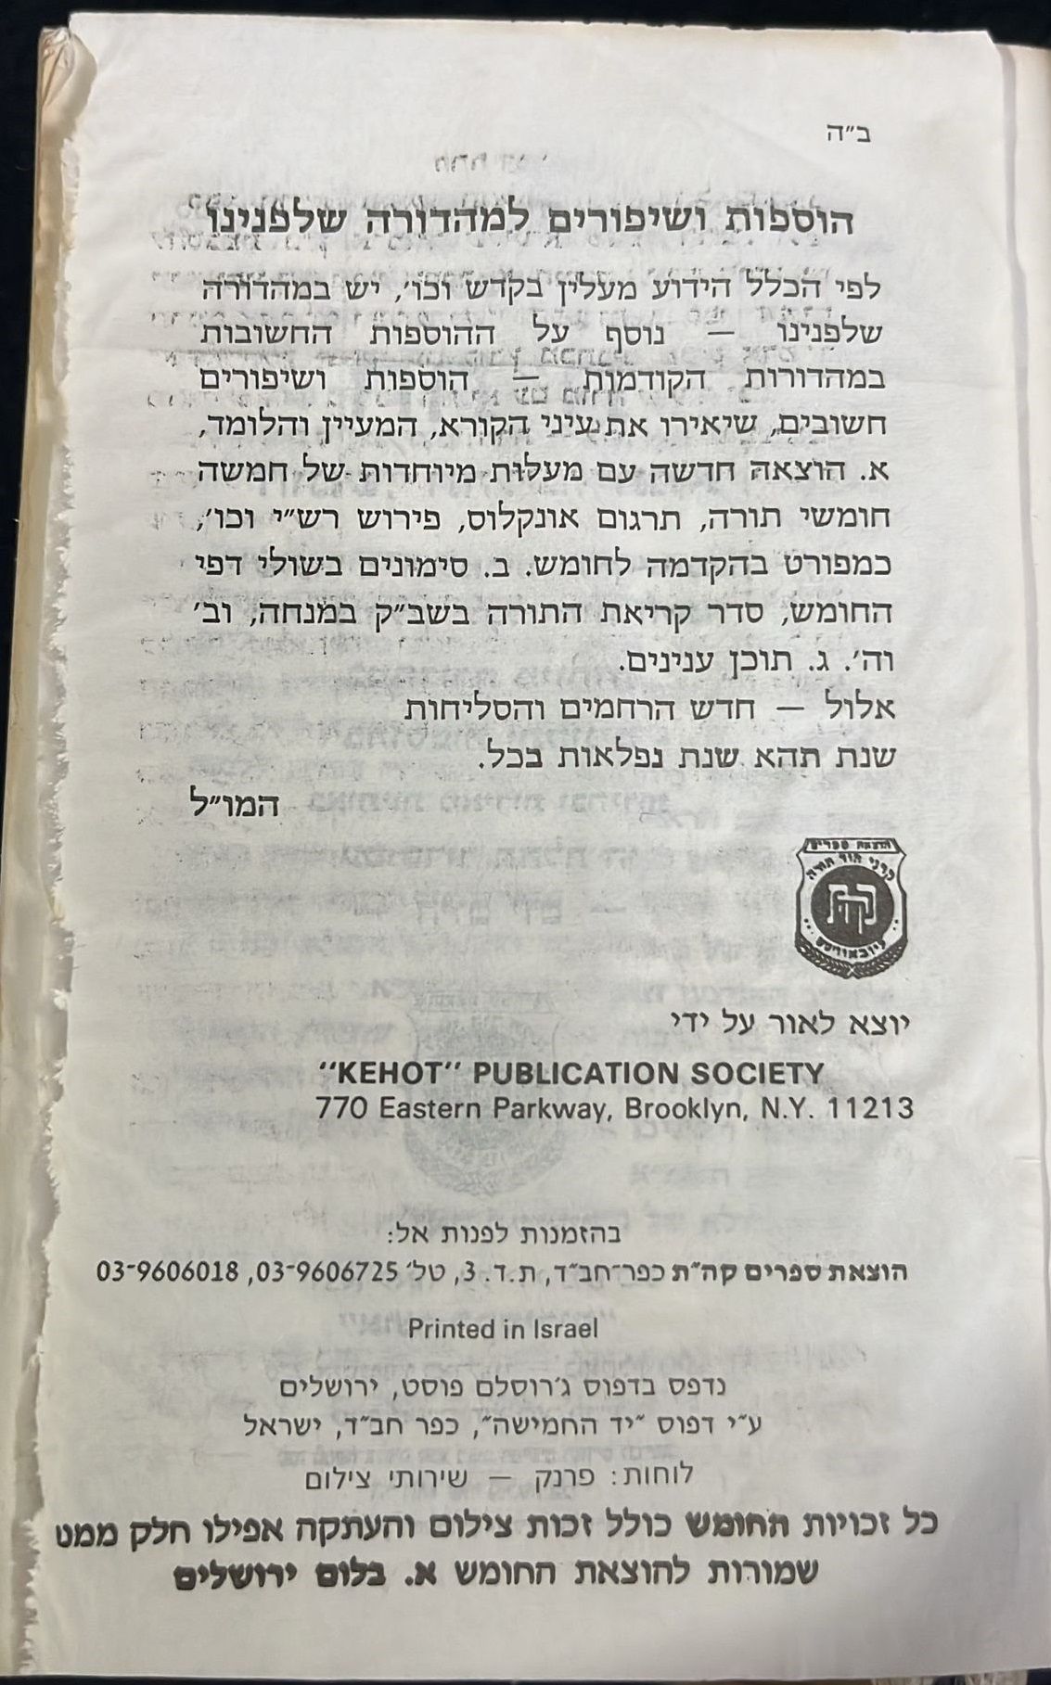
Using the AI Metadata Assistant for non-Latin script items
The cataloger has photographed the front cover, title page, and title verso page.

Slide 77
Using the AI Metadata Assistant for non-Latin script items
While in the Metadata Editor we will now do "New > Create with AI Assistant" and fill in the information.
Details are on the next slide.
We will load all three images to the “New record from AI Assistant” page and enter only the title (the only mandatory field).
We enter the title in non-Latin script

Slide 78
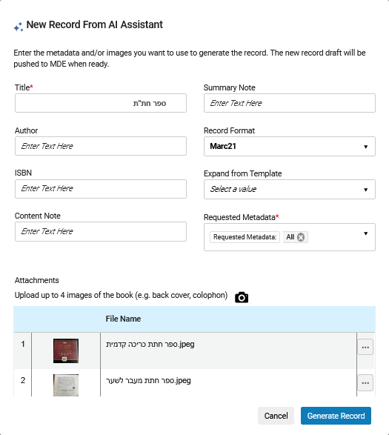
Using the AI Metadata Assistant for non-Latin script items
Title in non-Latin script
Only the title has been added. Author and ISBN have been left blank (even though we do have that information, we are showing that it is not necessary)
Files of non-Latin script images and file names in non-Latin script.

Slide 79
Using the AI Metadata Assistant for non-Latin script items
We will now click “Generate Record”

Slide 80
Using the AI Metadata Assistant for non-Latin script items
We receive the following message: "Successfully submitted for AI processing - please note that this may take a few minutes, and the requested draft will be pushed to MDE when ready. You may continue working in Alma as usual while the process runs in the background."

Slide 81
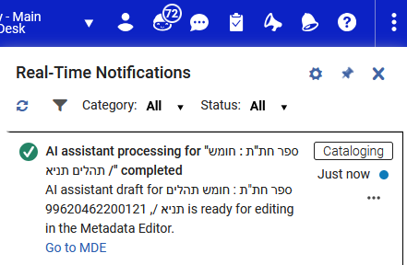
Using the AI Metadata Assistant for non-Latin script items
Shortly thereafter we receive the following Real-Time Notification: " AI assistant processing for "ספר חת"ת : חומש תהלים תניא /" completed
AI assistant draft for ספר חת"ת : חומש תהלים תניא /, 99620462200121 is ready for editing in the Metadata Editor.
Go to MDE."

Slide 82
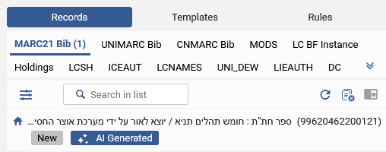
Using the AI Metadata Assistant for non-Latin script items
The new record appears in the navigation pane of the Metadata Editor with an "AI Generated" badge.
The badge enables the cataloger to easily identify the fact that this is an AI generated draft requiring review and is removed once the record has been saved.
Note that this is only a draft and has not yet been saved.
The record has not been saved. It is "New" and can be edited and then saved

Slide 83
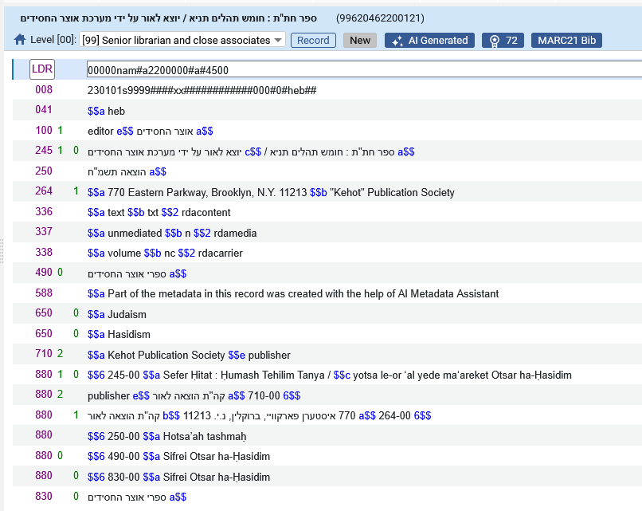
Using the AI Metadata Assistant for non-Latin script items
Here is the new record
The AI Metadata Assistant added a more complete title than we entered in the form, and added a subfield c “Statement of responsibility”
The AI Metadata Assistant added an 880 “Alternate Graphic Representation” for the 245 and other fields.

Slide 84

Using the AI Metadata Assistant for non-Latin script items
Now we can edit as desired and save. The new saved record is below.
Note that after saving the record the 650_0 headings automatically got linked to LCSH.

Slide 85
Feedback

Slide 86

Feedback
The “Feedback” button appears when working on a draft that was created using the AI Metadata Assistant.
The cataloger can score the quality of the AI suggested metadata from 1 (Poor) to 5 (Excellent) and provide a comment with the details on what was good / bad etc. in the returned metadata.
The feedback scores are sent to the Alma team, and used to monitor and improve the quality of returned metadata over time

Slide 87


Feedback
Give a rating and optionally provide written feedback and submit

